Slide 1


Introduction to Databases
A database is a structured collection of data, typically stored and accessed electronically from a computer system. It is designed to efficiently manage, retrieve, and update data. Databases play a crucial role in storing and organizing information for various purposes, from scientific research to business operations. In the field of bioinformatics, databases are essential for storing biological data, such as DNA sequences, protein structures, and gene expressions.
These databases enable scientists and researchers to analyze, compare, and interpret biological information, leading to significant advancements in the understanding of genetics, diseases, and evolutionary patterns. Bioinformatics databases serve as valuable resources for geneticists, biologists, and healthcare professionals, supporting their research efforts to develop new treatments, diagnose diseases, and enhance agricultural practices.

Slide 2

What is a database?
A database is a structured collection of data organized for easy access, management, and retrieval. It is designed to facilitate efficient data storage, retrieval, and manipulation. Databases can be as simple as a text file with a list of names or as complex as a large, multi-dimensional data warehouse. They play a crucial role in storing and managing vast amounts of information, providing a foundation for various applications and technologies.
Relational databases, NoSQL databases, and object-oriented databases are some common types. Relational databases use a structure that allows the identification of a real-world entity. NoSQL databases are flexible, scalable, and provide high performance for large datasets. Object-oriented databases are designed to work with object-oriented programming languages.
Utilized in both personal and professional contexts, databases are integral to modern information systems and are essential for the storage and retrieval of vast amounts of data.

Slide 3

Types of Databases
Relational Databases: These databases use a structure that allows the use of predefined tables to store and manage data. They are widely used in various applications and are known for their strong consistency and reliable performance.
NoSQL Databases: These databases are designed to handle large sets of unstructured data and can be used to build modern applications. They are flexible, scalable, and often used for real-time web applications.
Graph Databases: This type of database is used to store data points and the relationships between them. They are particularly useful for data that involves many connections, such as social networks and recommendation systems.

Slide 4

Bioinformatics Database Introduction
In the realm of bioinformatics, databases play a critical role in organizing and storing vast amounts of biological data. These databases are specifically designed to handle biological information, such as nucleotide and protein sequences, macromolecular structures, and functional genomics data.
They serve as invaluable resources for researchers, allowing for efficient data retrieval, analysis, and interpretation. Furthermore, bioinformatics databases are essential for the development and validation of computational methodologies, algorithms, and tools used in biological research.

Slide 5
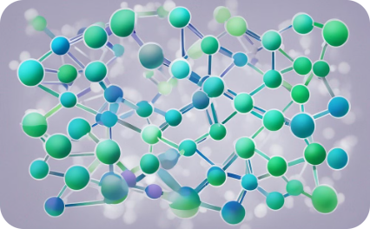
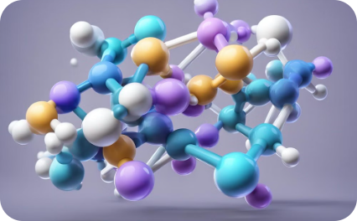

Examples of bioinformatics databases
Genomic Databases
Protein Structure Databases
Biomedical Literature Databases
Genomic databases house vast amounts of genetic information, including DNA sequences, gene annotations, and genetic variations. They are essential for researchers studying genomes, gene expression, and genetic diseases.
Protein structure databases provide detailed information on the 3D structures of proteins, offering insights into their functions, interactions, and potential drug targets. They play a crucial role in drug discovery and structural biology research.
Biomedical literature databases aggregate peer-reviewed research articles, abstracts, and citations, facilitating access to valuable scientific knowledge for researchers, healthcare professionals, and policymakers.

Slide 6
Importance of Bioinformatics Databases
Data Organization and Storage
Integration of Multi-Omics Data
Support for Computational Tools
Community Collaboration and Knowledge Sharing
Bioinformatics databases play a crucial role in organizing and storing vast amounts of biological data, including DNA sequences, protein structures, and genetic variations. This centralized storage allows researchers to access, retrieve, and analyze the data efficiently, contributing to the advancement of biological science.
These databases facilitate the integration of multi-omics data, such as genomics, transcriptomics, and proteomics, enabling comprehensive analyses and insights into complex biological processes and disease mechanisms. This integrated approach is essential for understanding the intricate relationships within biological systems.
Bioinformatics databases provide a platform for the development and utilization of computational tools and algorithms for data analysis, visualization, and modeling. This support fosters innovation in bioinformatics research and contributes to the development of advanced analytical methods.
These databases promote collaboration among researchers and scientists by providing a common platform to share data, findings, and analytical methods. This collaborative environment accelerates the pace of scientific discovery and fosters a culture of knowledge sharing and transparency.

Slide 7
Facilitating Research and Analysis
Data Organization
Data Integration
Bioinformatics databases facilitate the systematic organization of biological data, including genetic sequences, protein structures, and other vital information. This enables researchers to efficiently access and analyze large volumes of data, leading to deeper insights and discoveries.
These databases provide a platform for integrating diverse biological data sources, allowing researchers to correlate and analyze information from different studies and experiments. This integration fosters a comprehensive understanding of complex biological processes and systems.
Accessible Tools
Collaborative Research
Bioinformatics databases offer a wide range of computational tools and algorithms that aid in data analysis, visualization, and interpretation. These tools empower researchers to perform advanced analysis and modeling, accelerating the pace of scientific discoveries.
By providing a centralized repository for data and analysis tools, bioinformatics databases promote collaboration among researchers and institutions. This collaboration fosters collective intelligence, leading to breakthroughs in understanding biological phenomena and addressing complex challenges.

Slide 8



Conclusion and future prospects
Technological advancements
1
Integration of AI and machine learning in database analysis
Data sharing and collaboration
2
Enhanced platforms for global scientific data exchange
Interdisciplinary research
3
Exploring connections between genomics, proteomics, and metabolomics
The future of bioinformatics databases is exciting, with technological advancements driving progress in data analysis and interpretation. The integration of AI and machine learning algorithms will revolutionize the way databases are utilized, enabling deeper insights into complex biological data.

